Slide 1

2018 Field Corn Weed Management Update
Eric P. Prostko
Professor/Extension Weed Specialist
Dept. Crop & Soil Sciences

Slide 2
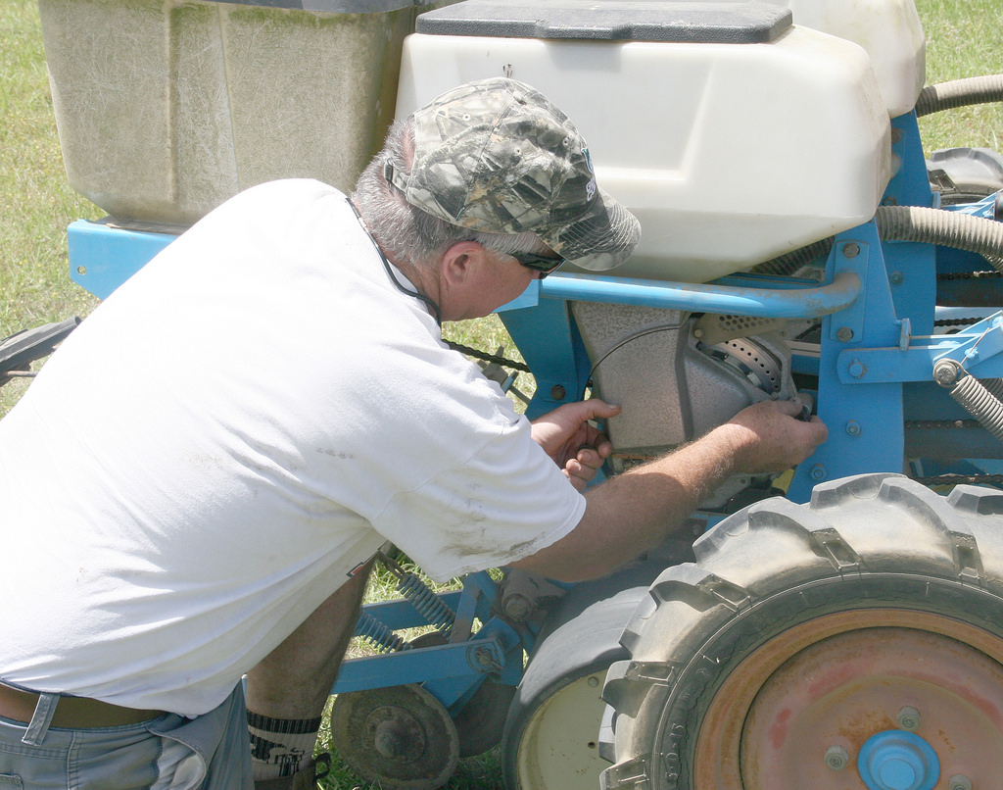
Field Corn Weed Control - General
Other mgt. practices are important!
  Tillage
  Plant population
  Row spacing
  Nematode, insect, disease control
  Irrigation
A healthy and uniformly spaced crop is better able to compete with weeds

Slide 3
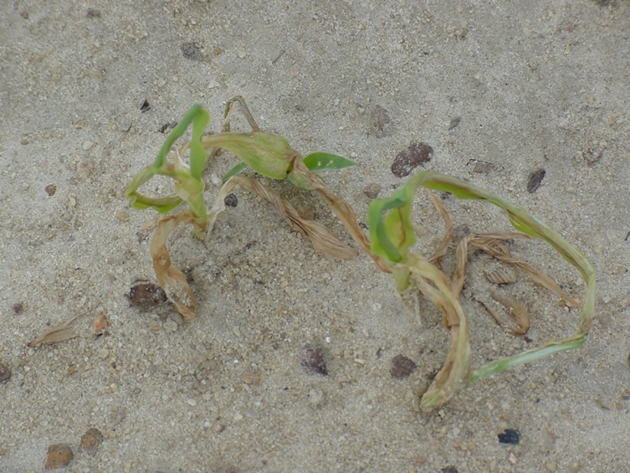
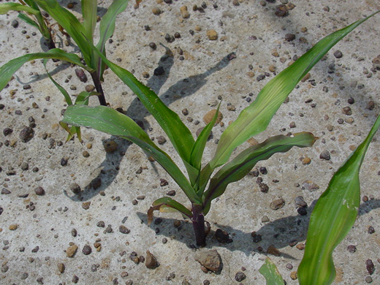
Herbicide Carryover in GA?
Never say never but ……
  low OM
  high sand content
  warm temperatures
  ample rainfall/irrigation

Slide 4
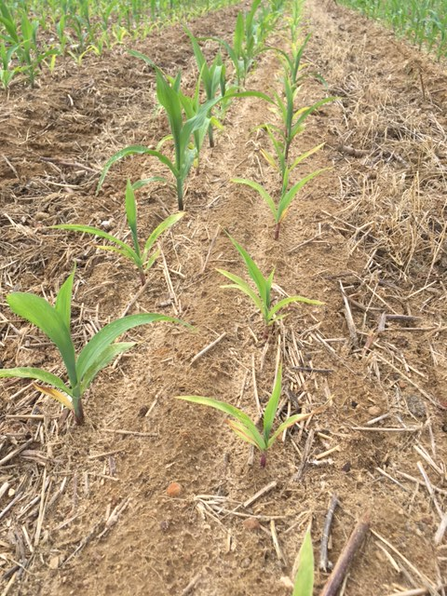
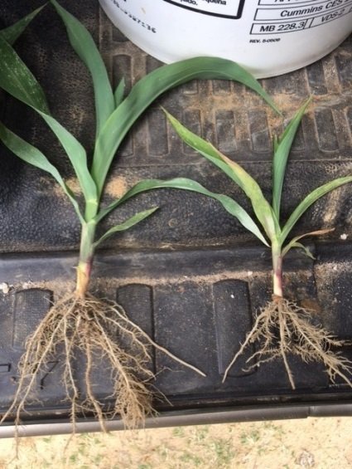
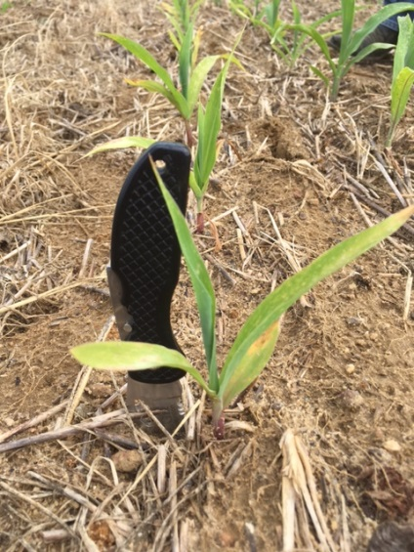
Herbicide Carryover or Nematodes
Burke County
April 2017
Stubby Root Nematodes
21/100cm³ of soil
>9 is threshold

Slide 5
Figure 1. Field Corn Yield Loss (%) Caused by Uncontrolled Weeds in Georgia Weed Science Research Trials (2007-2017).
Treated vs. Non-treated
200 Bu/A X 0.36 X $3.50 = $252/A
200 Bu/A X 0.16 X $3.50 = $112/A

Slide 6
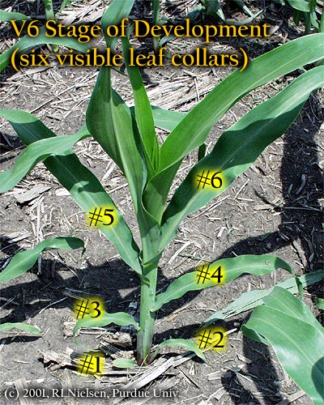
Later POST Applications?
V6 stage
  all leaves are initiated
  Ear shoot initiation
  Kernel rows/ear begins
  Tassel initiation
  Growing point above soil surface
  ~500 GDD

Slide 7
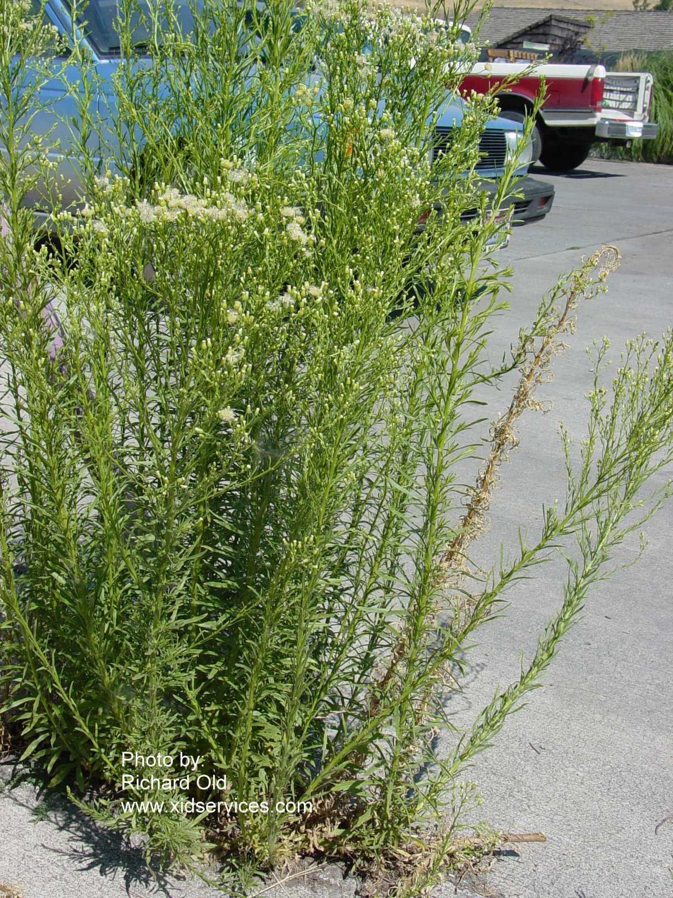
Marestail in Field Corn
(i.e. Horseweed)
Tillage
Burndown
  Liberty (glufosinate)
    + atrazine?
  Glyphosate +
    Dicamba or 2,4-D?
    Sharpen + MSO
      0 day plant-back
  Paraquat + atrazine
Residual
  atrazine
In-Crop
  Liberty (LL)
  Dicamba
  2,4-D
    Enlist corn - 2,4-D choline

Slide 8
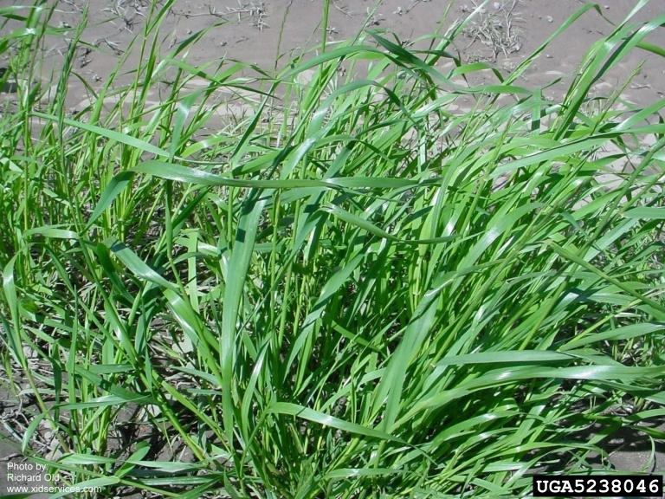
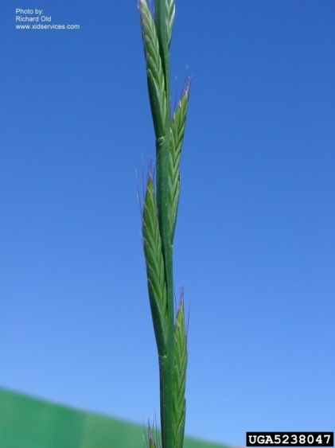
Ryegrass Control
Glyphosate-resistant or not?
Fall (mid-October – Mid-November)
  Tillage (double disk) or
  Dual Magnum @ 1.33 pt/A
Mid-January – Mid-February
  2” - 6” tall
  Select Max 0.97EC @ 6 oz/A or Clethodim 2EC @ 6-8 oz/A
    Corn – 30 DBP
    Nighttime temps > 47⁰ F
March 1-20
  Gramoxone 2SL @ 3-4 pt/A
  May need 2 applications (10-14 days apart)
  + atrazine @ 1 qt/A
Source: Dr. Jason Bond, MS State University

Slide 9
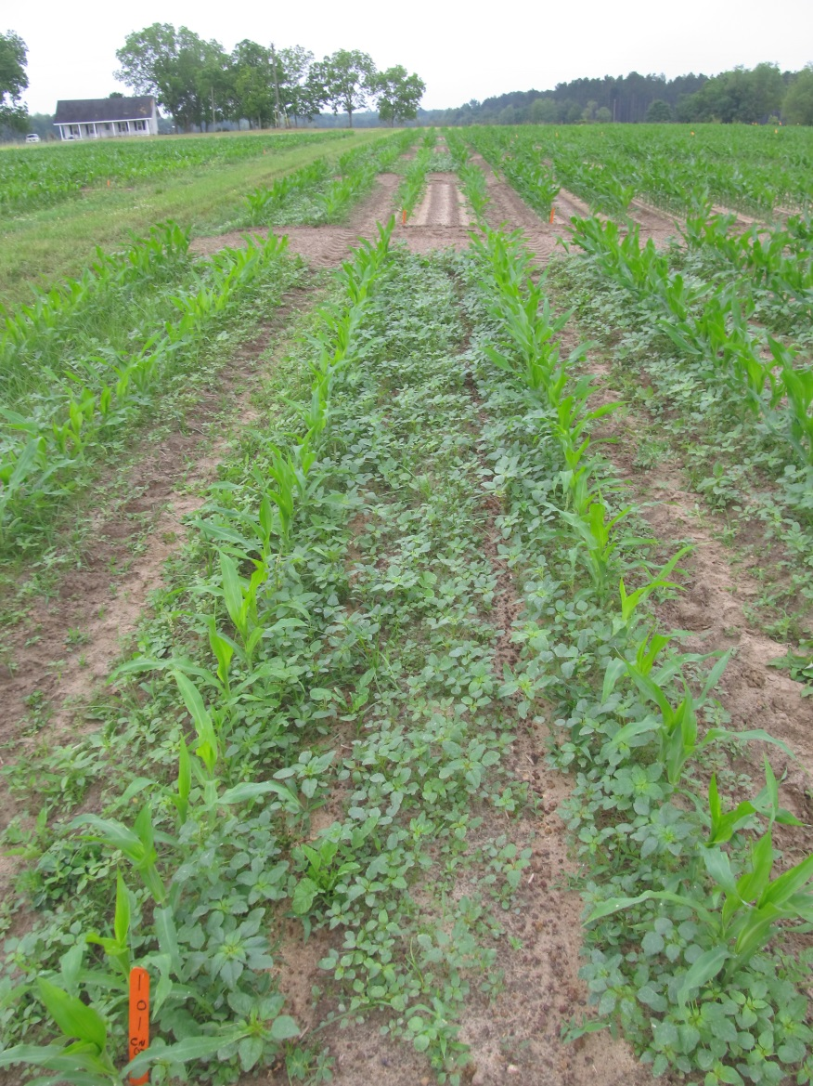
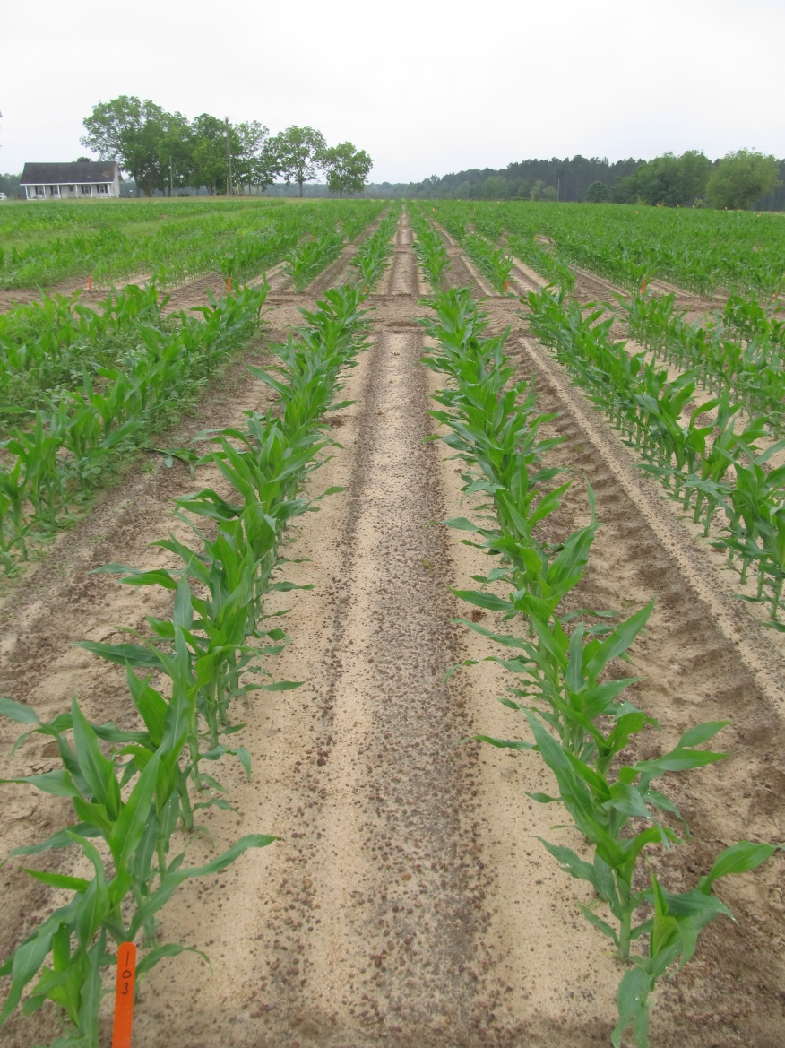
Field Corn Weed Control - 2017
NTC
Roundup P-Max @ 32 oz/A
Atrazine @ 64 oz/A
Prowl H₂O @ 32 oz/A
CN-02-17
April 27
13 DAT

Slide 10
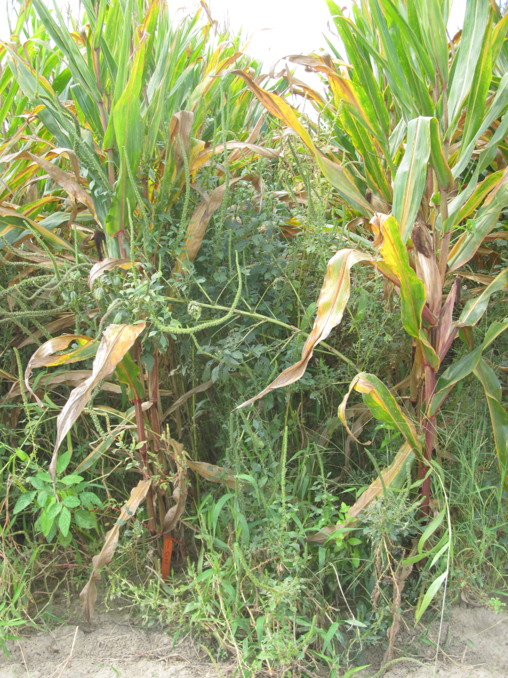
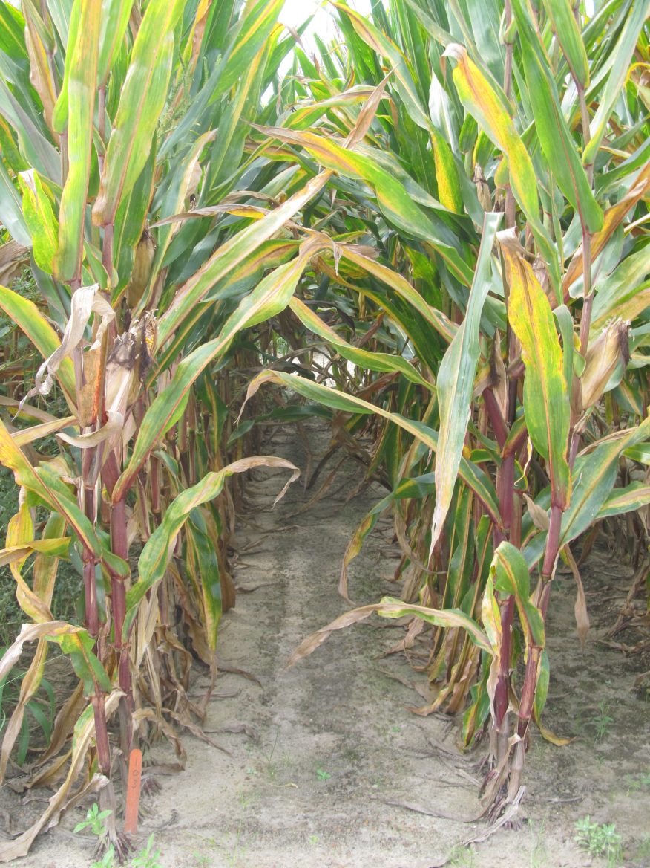
Late-Season Weed Control
NTC
Roundup P-Max @ 32 oz/A
Atrazine 4L @ 64 oz/A
Prowl H₂0 @ 32 oz/A
Applied 17 DAP
CN-02-17
July 24
118 DAP

Slide 11
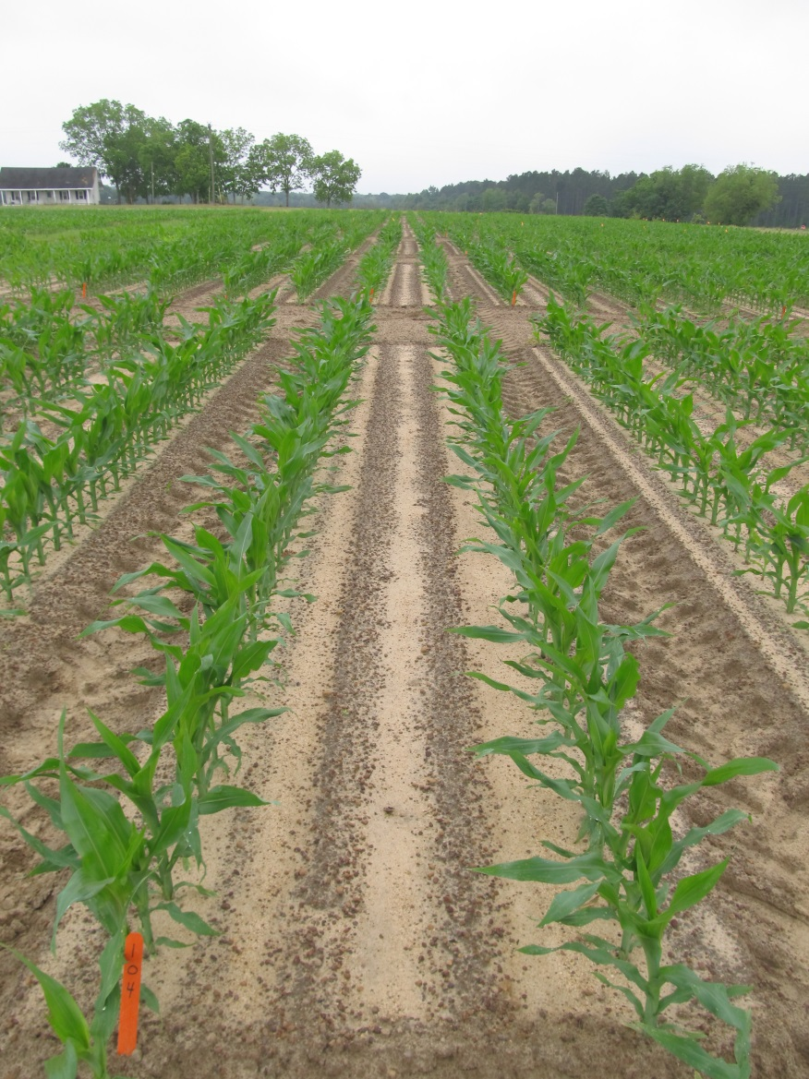
Field Corn Weed Control - 2017
NTC
Liberty @ 29 oz/A
Atrazine @ 64 oz/A
Prowl H₂0 @ 32 oz/A
CN-02-17
April 27
13 DAT

Slide 12
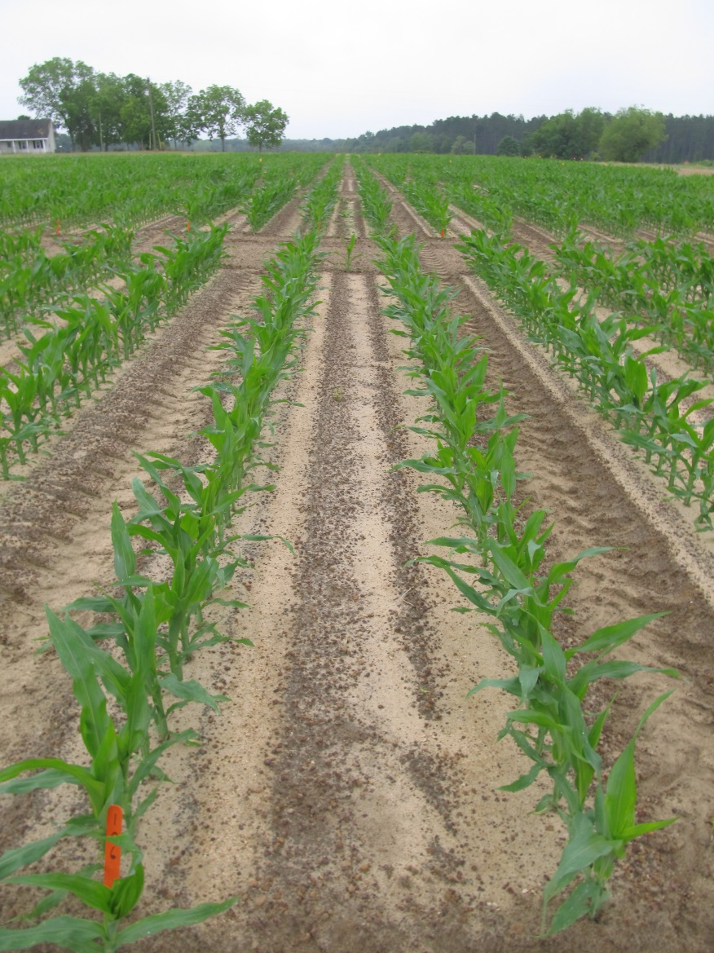
Field Corn Weed Control - 2017
NTC
Halex GT @ 58 oz/A
Atrazine @ 64 oz/A
Adept @ 0.25% v/v
CN-02-17
April 27
13 DAT

Slide 13
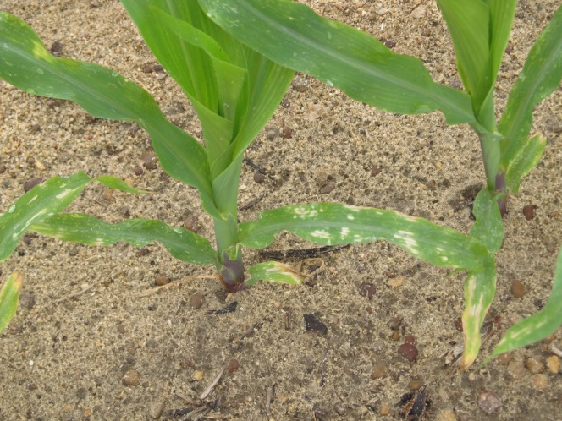
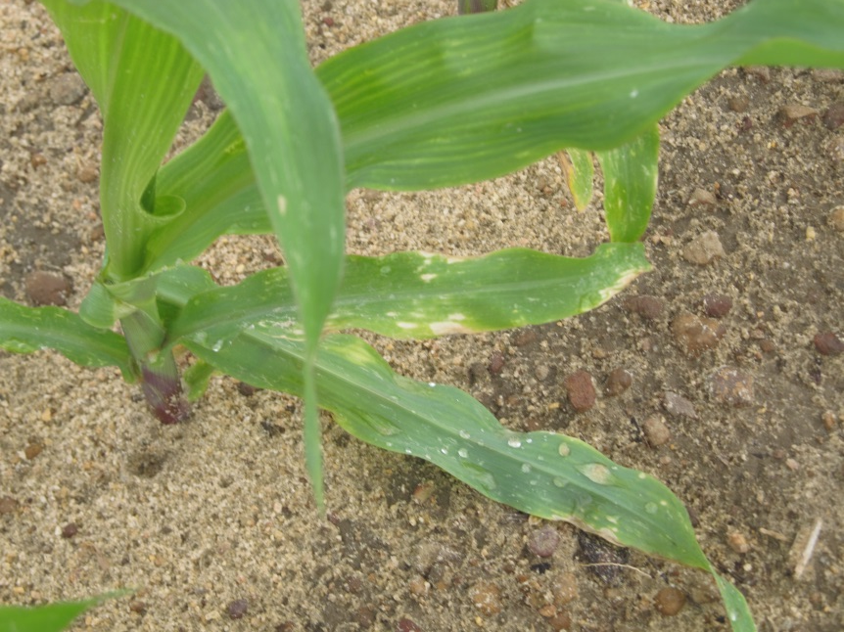
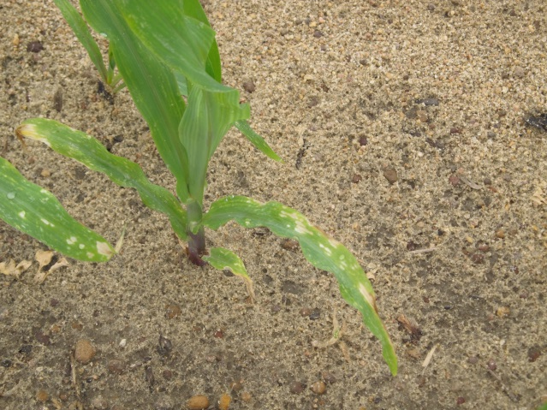
Normal Halex GT Injury
CN-05-17
April 24
7 DAT

Slide 14
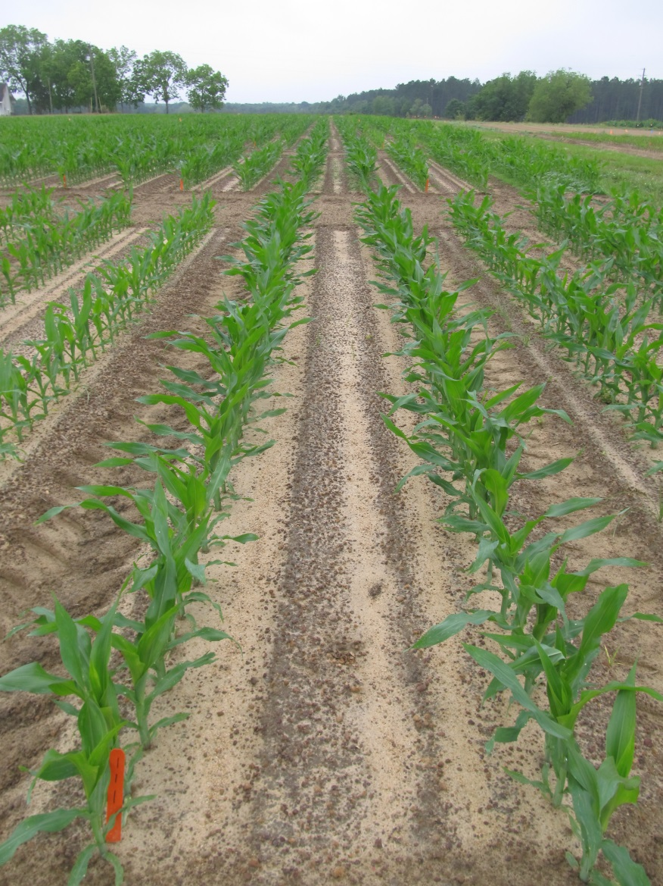
Field Corn Weed Control - 2017
NTC
Revulin Q @ 3.4 oz/A
Atrazine @ 64 oz/A
Adept @ 0.25% v/v
CN-02-17
April 27
13 DAT

Slide 15
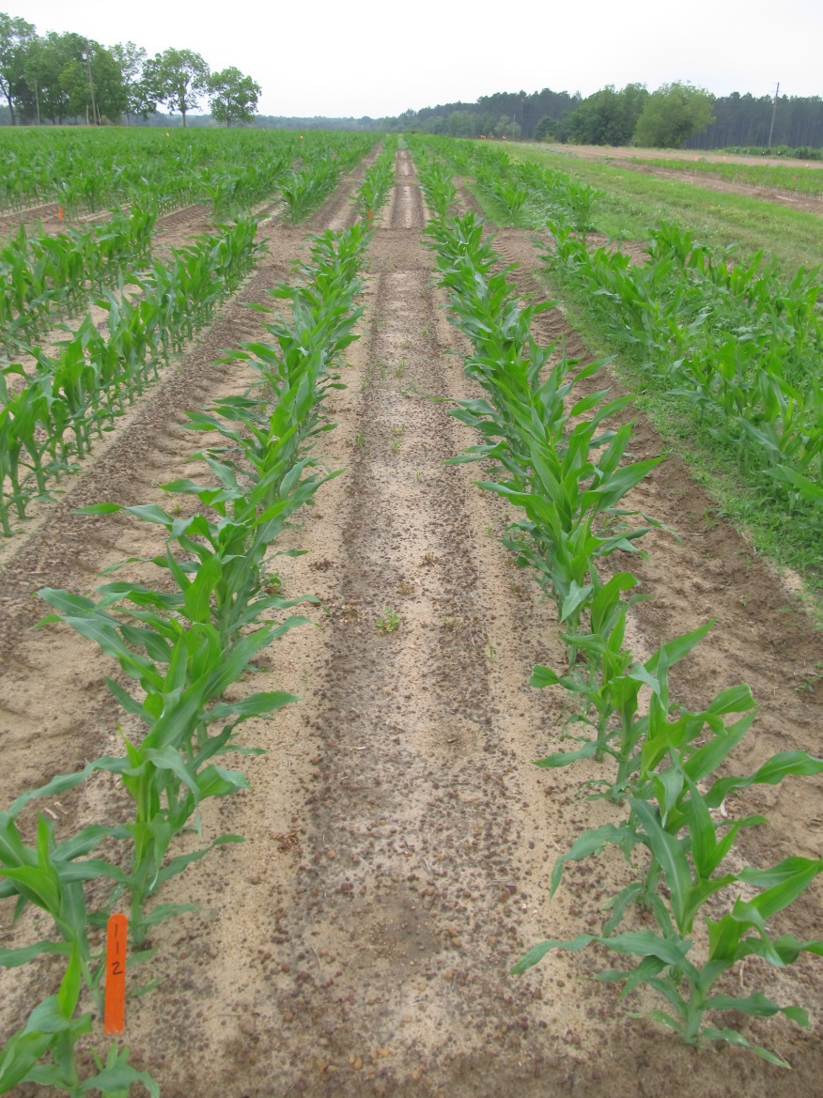
Field Corn Weed Control - 2017
NTC
Laudis @ 3 oz/A
Atrazine @ 64 oz/A
MES 100 @ 1% v/v
CN-02-17
April 27
13 DAT

Slide 16

Morningglory Control in Field Corn

Slide 17
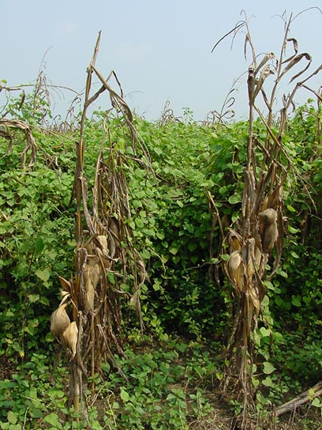
Morningglory Control in Corn
as much atrazine as possible
1.0 lb/A – PRE fb 1.5 lb/A – POST
  small grain rotations
2,4-D, Clarity, Status, Aim, ET, Evik (PDIR)
  Enlist Corn???
Liberty-Link® Corn Systems
split applications of glyphosate (RR corn)
  * 1st application + atrazine
Harvest Aids
  Aim
Early-harvest

Slide 18
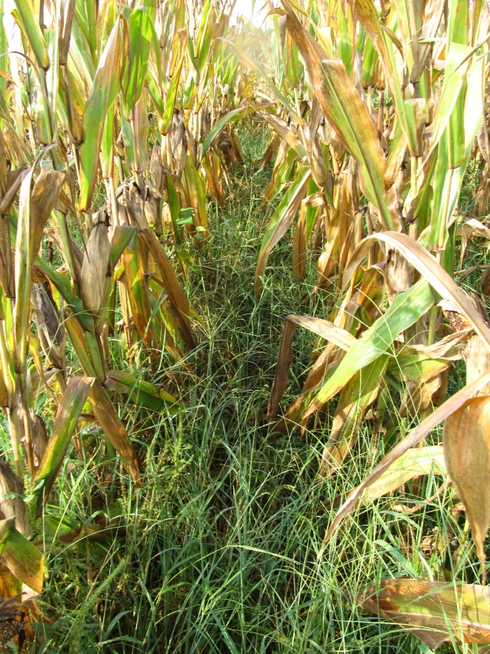
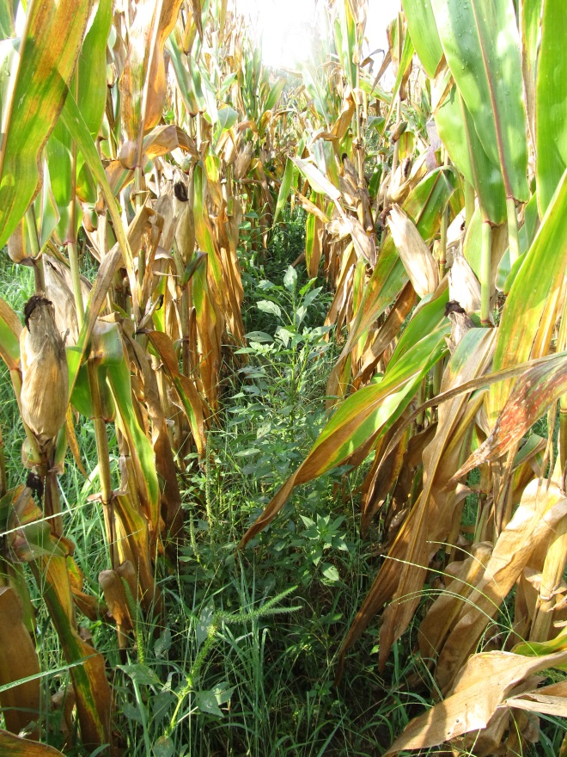
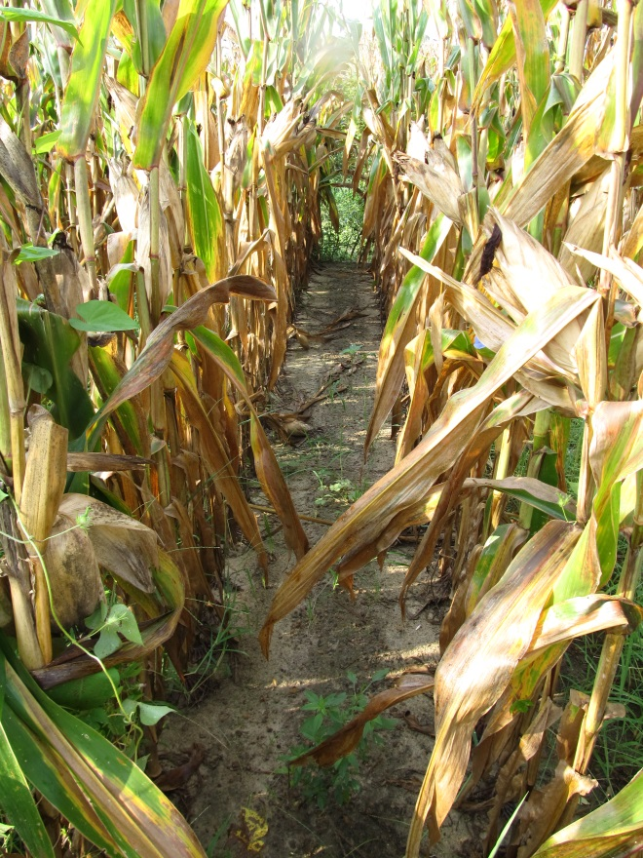
Do we need to rethink laybys????
NTC
Atrazine 4L @ 32 oz/A (PRE)
Roundup WM @ 32 oz/A +
Atrazine @ 48 oz/A (21 DAP)
Atrazine 4L @ 32 oz/A (PRE)
Roundup WM @ 32 oz/A +
Atrazine @ 48 oz/A (21 DAP)
Evik @ 2 lb/A + NIS (37 DAP)
CN-06-15
July 29
133 DAP

Slide 19
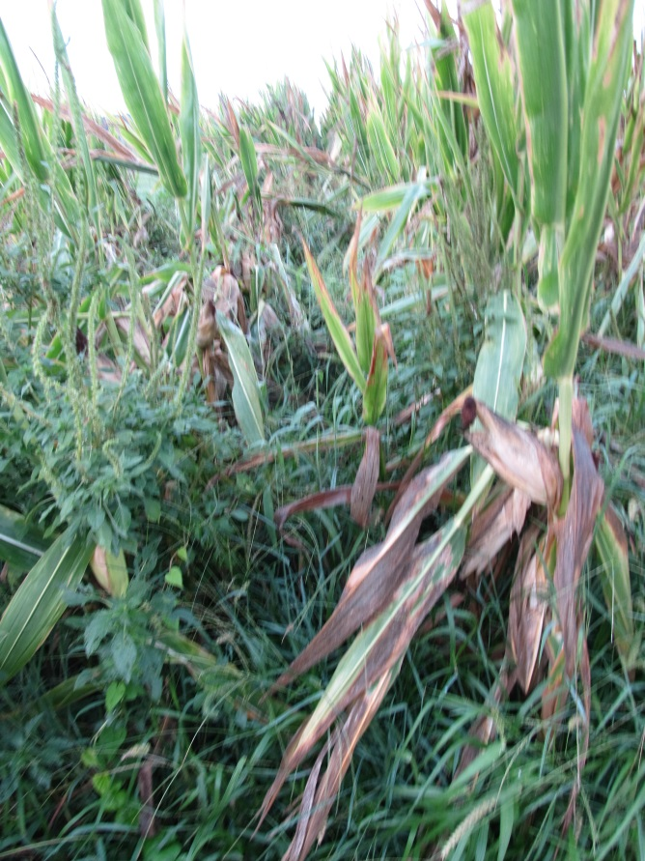
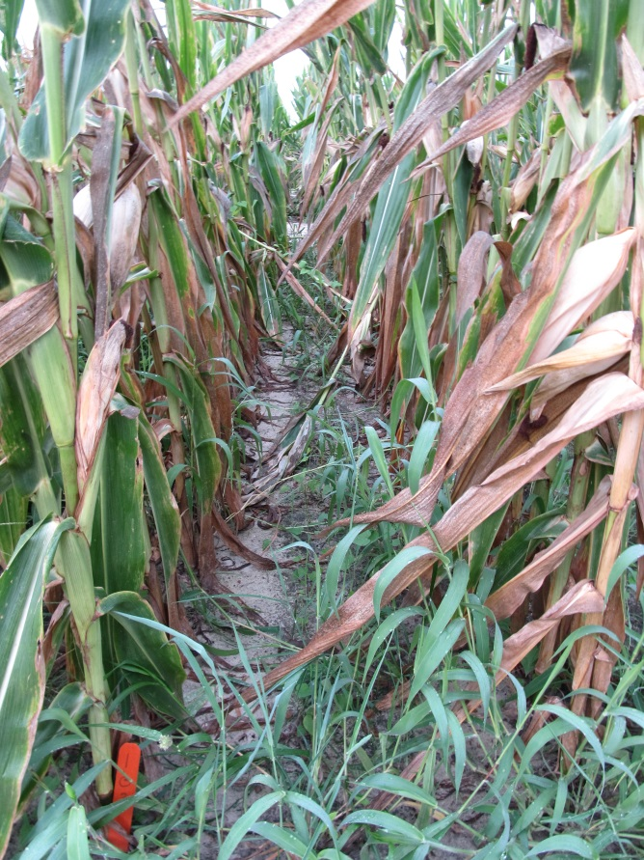
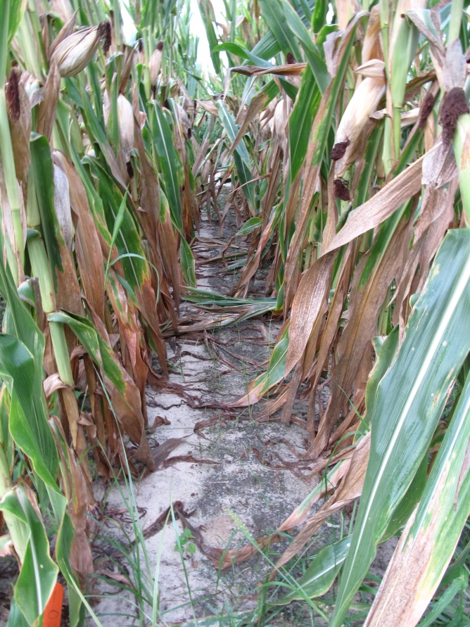
Evik or Not?
NTC
Atrazine 4L @ 32 oz/A (PRE)
Roundup P-Max 5.5SL @ 32 oz/A (POST)
Atrazine 4L @ 48 oz/A (POST)
Atrazine 4L @ 32 oz/A (PRE)
Roundup P-Max 5.5SL @ 32 oz/A (POST)
Atrazine 4L @ 48 oz/A (POST)
Evik 80DG @ 2 lbs/A (PDIR)
NIS @ 0.25% v/v (PDIR)
CN-01-16
July 7
108 DAP

Slide 20
What herbicides can you use in field corn if you have resistance to glyphosate, atrazine, and/or ALS herbicides?
Residuals
  Zidua
  Dual Magnum
  Warrant
  Prowl
Postemergence*
  Liberty
  Status
  Revulin Q
  Impact/Armezon
  Laudis
  Capreno
  Halex GT
  2,4-D
* double-crop soybean rotations?

Slide 21
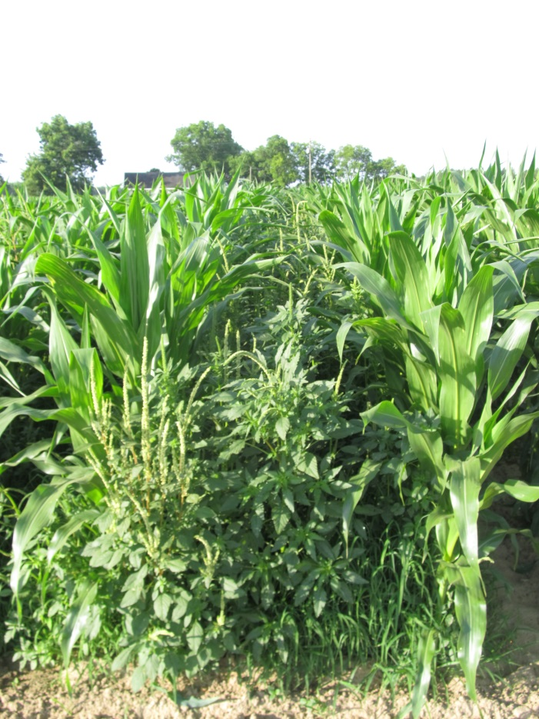
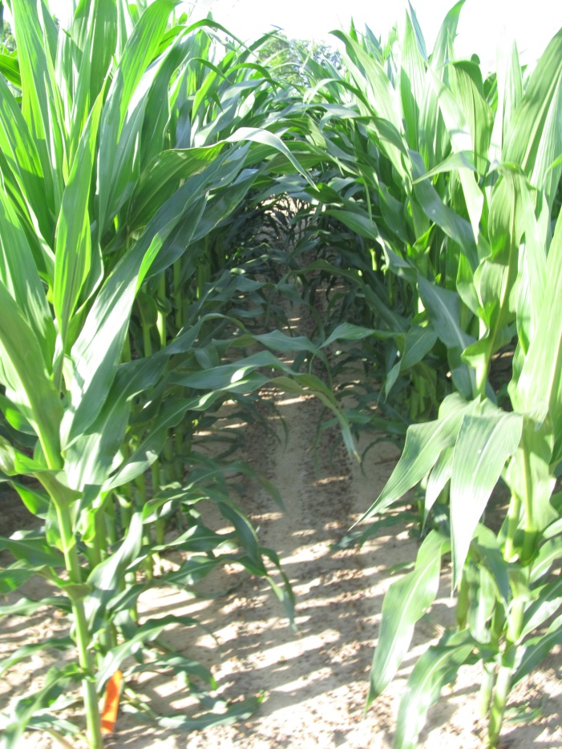
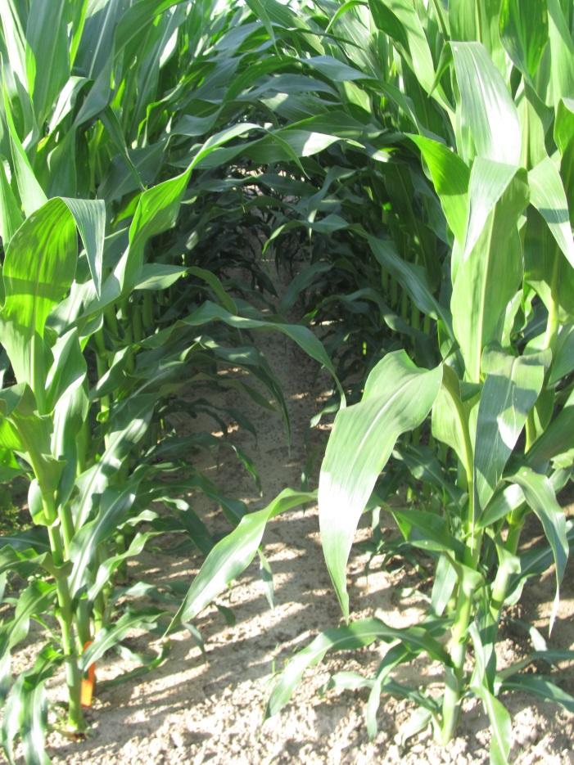
Field Corn Weed Control Without Atrazine or Glyphosate - 2017
NTC
(209 Bu/A)
Dual II Magnum @ 16 oz/A (PRE)
Laudis @ 3 oz/A (28 DAP)
COC @ 1% v/v (28 DAP)
AMS Xtra @ 2.5% v/v (28 DAP)
(251 Bu/A)
Warrant @ 48 oz/A (PRE)
Laudis @ 3 oz/A (28 DAP)
COC @ 1% v/v (28 DAP)
AMS Xtra @ 2.5% v/v (28 DAP)
(247 Bu/A)
CN-03-17
May 18
51 DAP
DKC 66-59

Slide 22
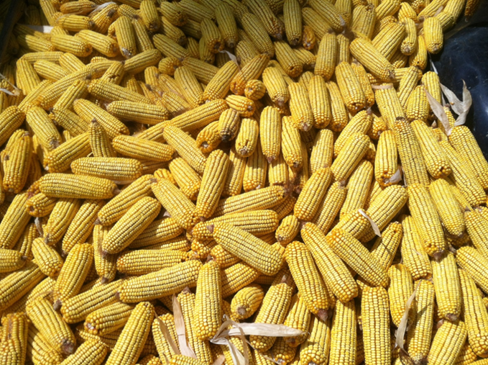
New (er) Stuff

Slide 23
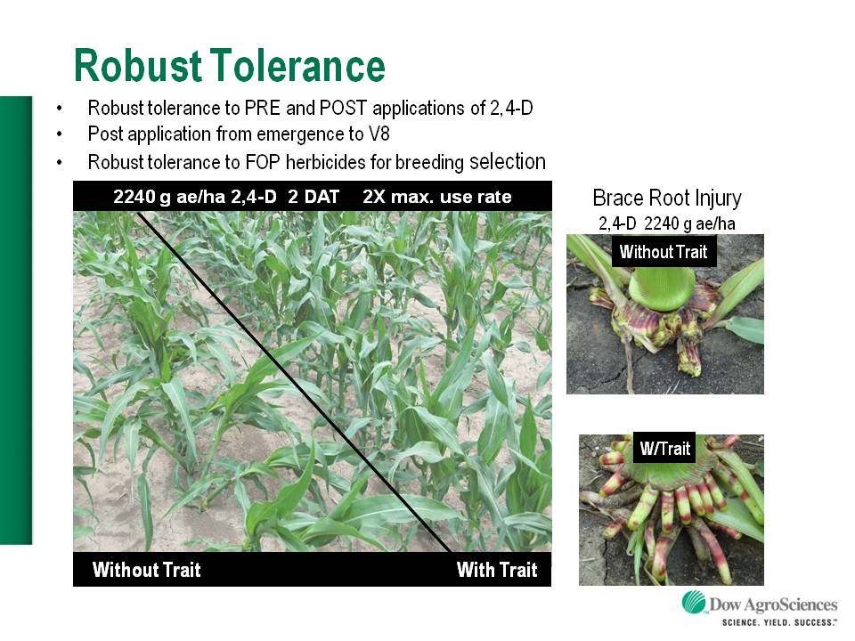
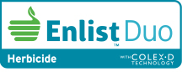
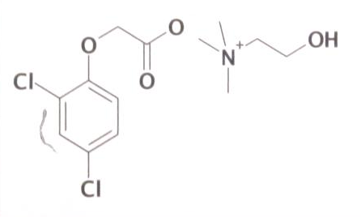

Enlist™ Herbicide Tolerant Corn
tolerance to 2,4-D and Assure + GLY
Trait was deregulated in September 2014 and herbicide in October 2014. U.S. launch in 2018 (SE??).
Colex-D™ technology
  2,4-D choline
  lower volatility
  lower drift potential
  enhanced handling/mixing characteristics
  reduced odor
1 PRE application + 2 POST applications (30” or V8 stage)
Enlist™ Duo
  DMA-Glyphosate (1.71 lb ae/gal) + 2,4-D choline (1.63 lb ae/gal)
Enlist™ One
  2,4-D choline (3.8 lb ae/gal)
2,4-D choline

Slide 24
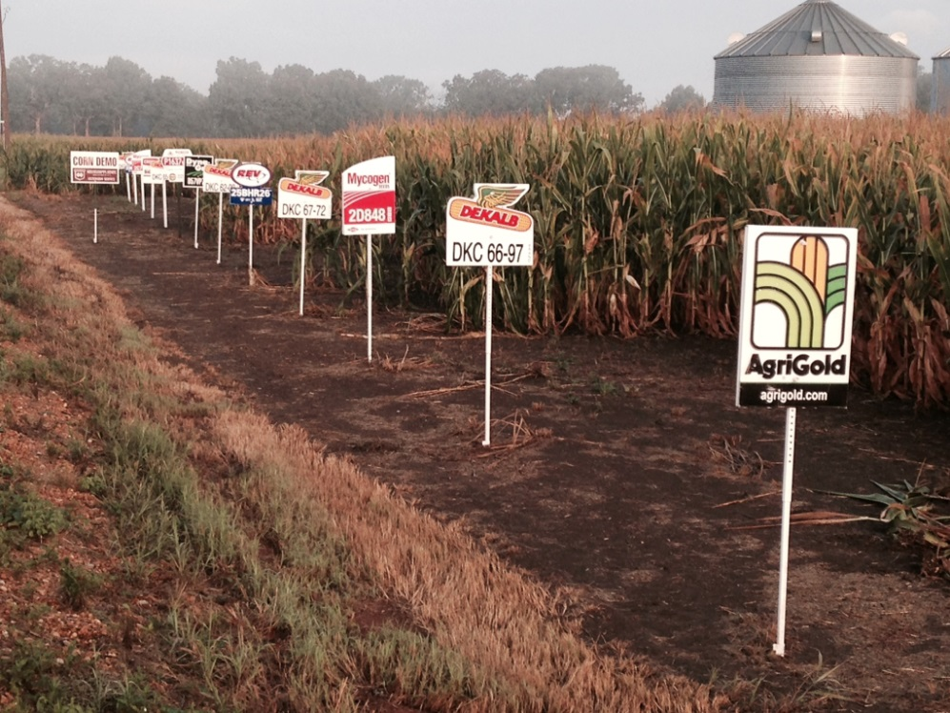
Enlist™ Field Corn Hybrids - 2018
China approval
  June 2017
Limited or no data for SE?????
  Broadbeck
  Dairyland
  Mycogen
  Pfister
  Prairie Brand

Slide 25
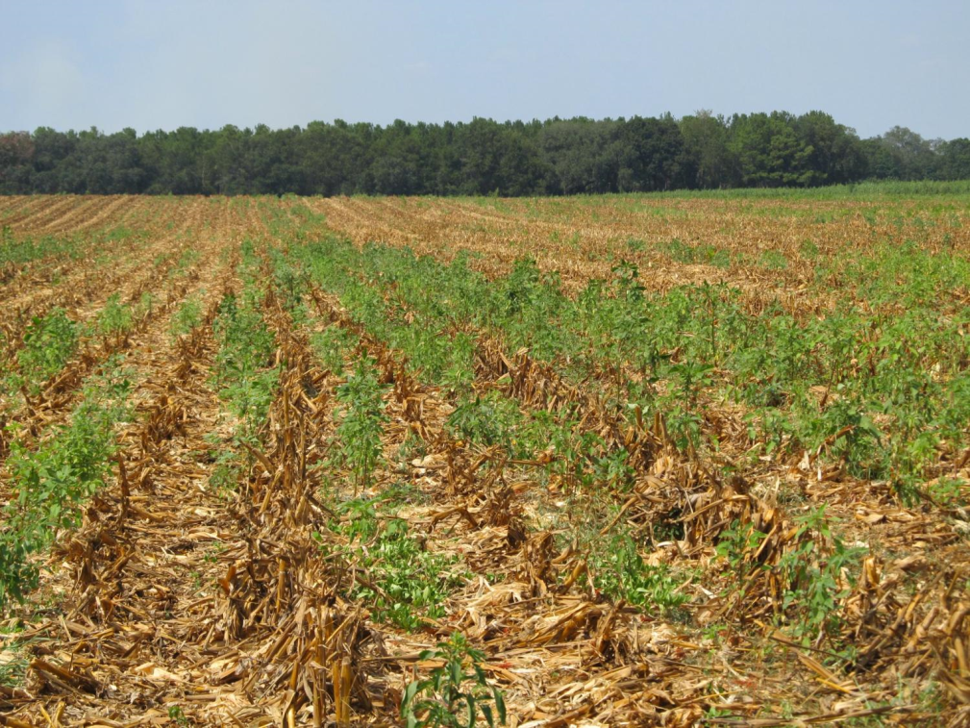
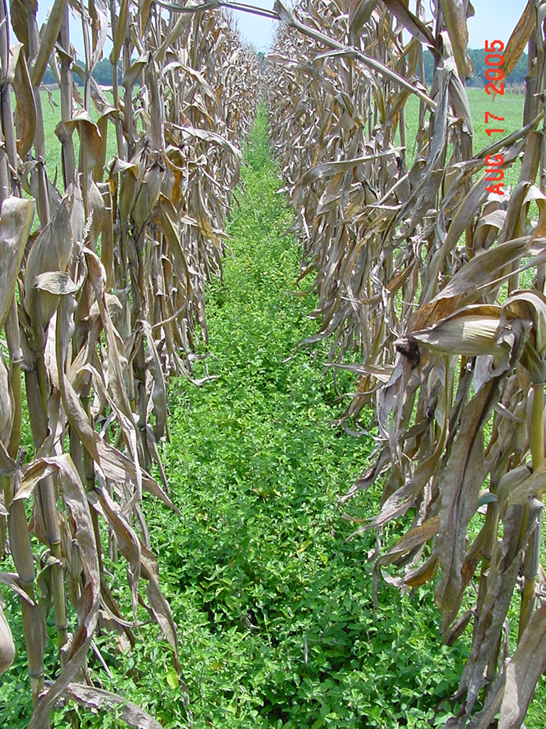
Post-Harvest
Palmer amaranth
tropical spiderwort
Benghal dayflower

Slide 26
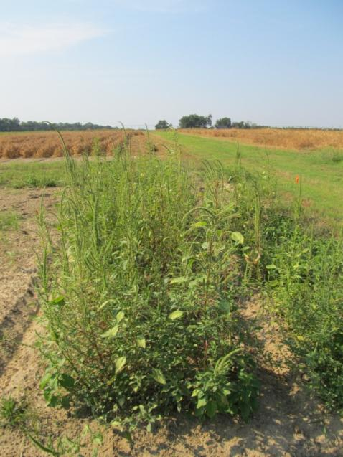
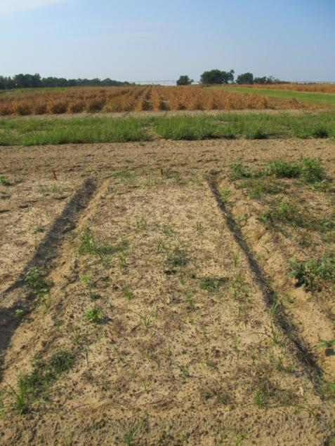
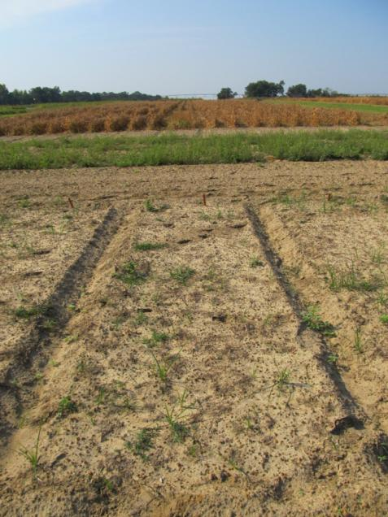
Post-Harvest Control of Palmer Amaranth
(8.1” average: 2”-17” range at application)
NTC
Gramoxone Inteon 2SL @ 3 pt/A
2,4-D Amine 3.8SL @ 1 pt/A
Primary @ 1% v/v
Gramoxone Inteon 2SL @ 3 pt/A
Clarity 4SL @ 8 oz/A
Primary @ 1% v/v
CN-01B-11
September 15
30 DAT

Slide 27
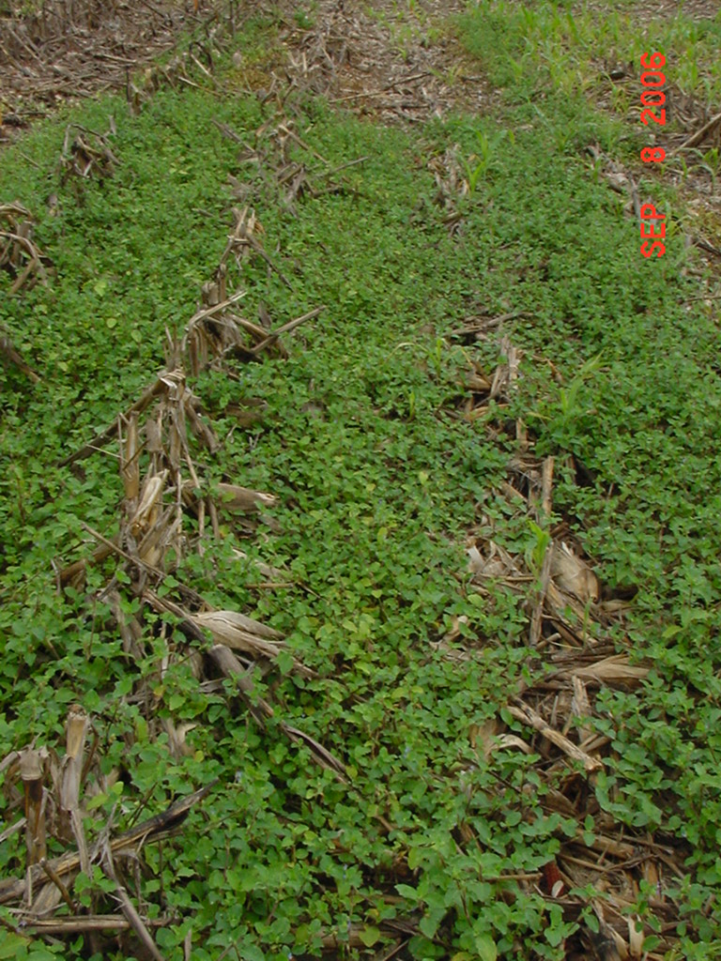
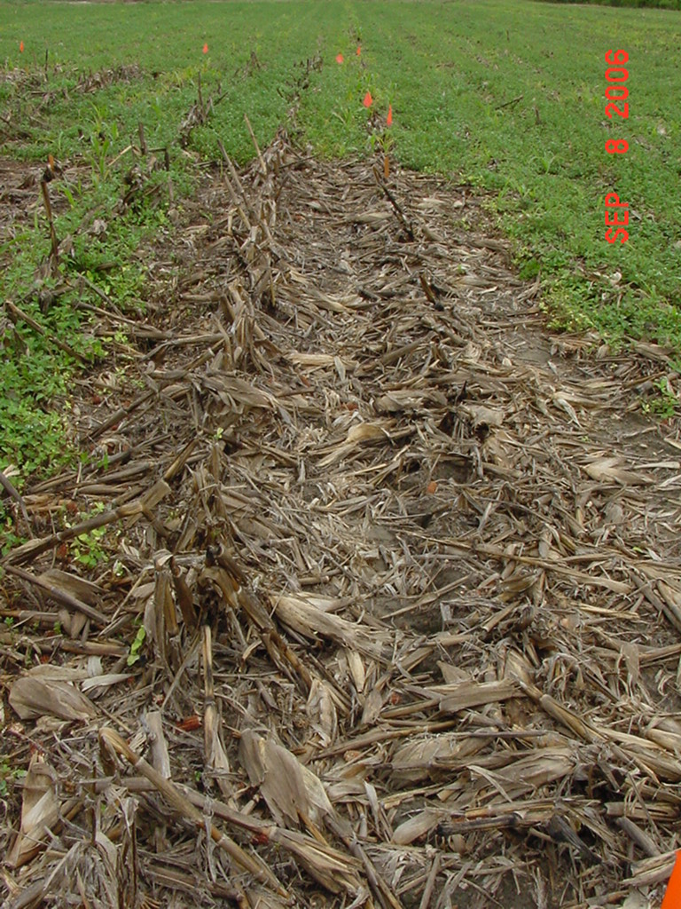
Post-Harvest Control of Tropical Spiderwort
Untreated
Gramoxone
POST1 + POST2
POST1: 8-10” tall COMBE
POST2: 2 weeks later
Photo 1 week after POST2

Slide 28
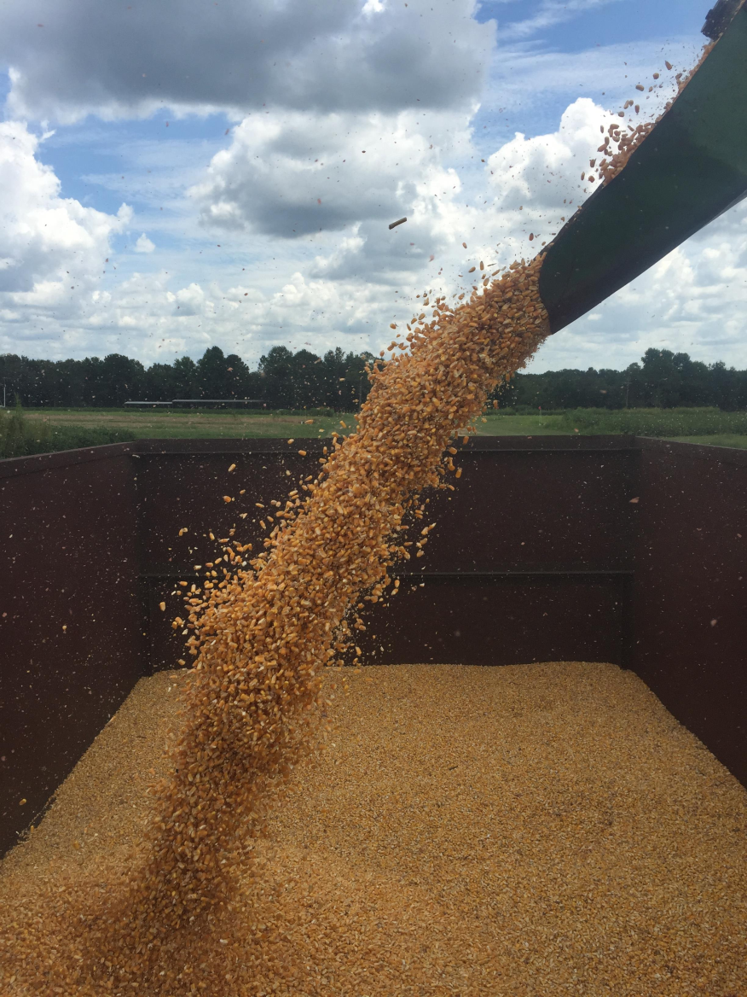
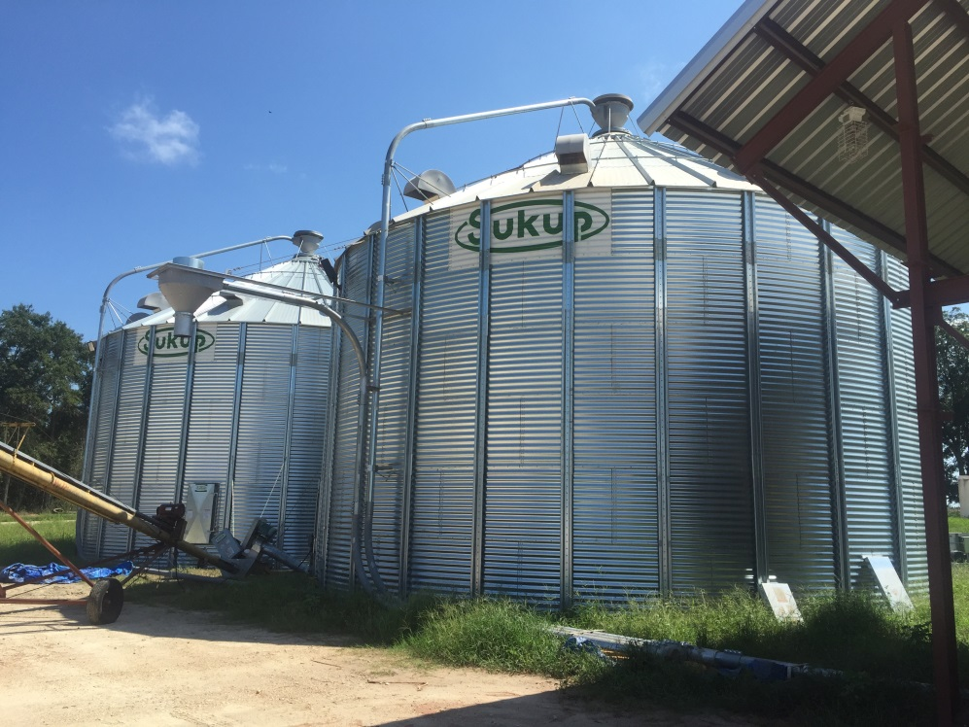
Questions/Comments?

